Slide 1

Assessment Submission
(Semester 4th EC (A) – 21-22)
Name of the student: - Ayush Gopaldas Bhutada
Roll No: - 25
Branch: - Electronics and communication
Section/Shift: - A/First Shift
Name of the course: - Environmental Science
Course Code: - : CHT252
Title of Presentation: - Introduction to Noise Pollution and its Causes

Slide 2
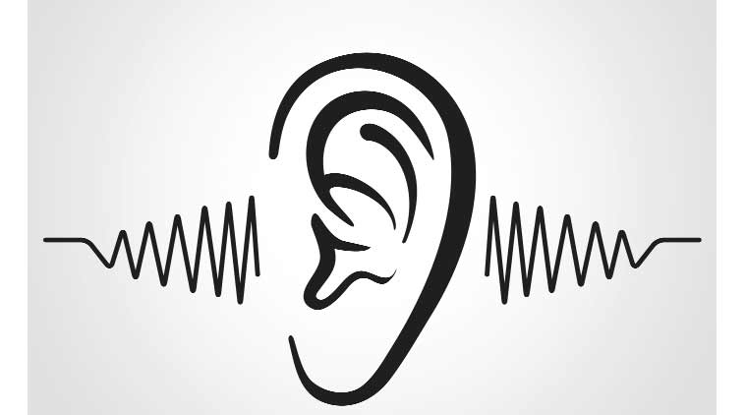
WHAT IS SOUND?
Sound is everything that we hear.
Anything capable of vibration and sending out single or multiple frequencies can produce a ‘Sound’.

Slide 3
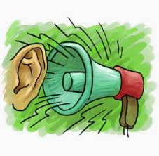
WHAT IS NOISE?
Noise is unwanted sound judged to be unpleasant, loud or disruptive to hearing.
The unbearable volume or voice or sound that is not suitable for human ear.

Slide 4
WHAT IS NOISE POLLUTION?
Noise pollution, also known as environmental noise or sound pollution is the propagation of noise with ranging impacts on the activity of human or animal life, most of them harmful to a degree.
The source of outdoor noise worldwide is mainly caused by machines, transport and propagation systems.
Poor urban planning may give rise to noise disintegration or pollution, side-by-side industrial and residential buildings can result in noise pollution in the residential areas include loud music, transportation, lawn care, maintenance, construction, electrical generators, wind turbines, explosions and people.

Slide 5
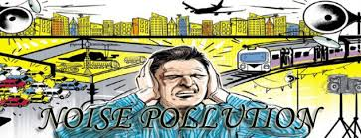
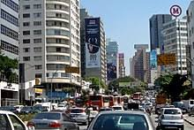
Documented problems associated with noise in urban environments go back as fas as ancient Rome. Today, the avarage noise levelof 98 decibels(dB) exceeds the WHO value of 50 decibels allowed for residential areas.
Research suggests that noise pollution in the United States is the highest in low income and racial minority neighbourhoods, and noise pollution associated with household electricity generators is an emerging environmental degradation in many developing nations.

Slide 6
High noise levels can contribute to cardiovascular effects in humans and an increased incidence of coronary artery disease.
In animals, noise can increase the risk of death by altering predator or prey detection and avoidance, interfere with reproduction and navigation, and contribute to permanent hearing loss.
A substantial amount of the noise that humans produce occurs in the ocean. Up until recently, most research on noise impacts has been focused on marine mammals, and to a lesser degree, fish.

Slide 7
In the past few years, scientists have shifted to conducting studies on invertebrates and their responses to anthropogenic sounds in the marine environment. This research is essential, especially considering that invertebrates make up 75% of marine species, and thus compose a large percentage of ocean food webs.
Of the studies that have been conducted, a sizable variety in families of invertebrates have been represented in the research. A variation in the complexity of their sensory systems exists, which allows scientists to study a range of characteristics and develop a better understanding of anthropogenic noise impacts on living organisms.

Slide 8
Effects of Noise Pollution on Health
On Humans:
Noise pollution affects both health and behavior. Unwanted sound (noise) can damage physiological health.
Noise pollution is associated with several health conditions, including cardiovascular disorders, hypertension, high stress levels, tinnitus, hearing loss, sleep disturbances, and other harmful and disturbing effects.
According to a 2019 review of the existing literature, noise pollution was associated with faster cognitive decline.

Slide 9
On wildlife: -
Anthropogenic noise can have a detrimental effect on animals, increasing the risk of death by changing the delicate balance in predator or prey detection and avoidance, and interfering with the use of the sounds in communication, especially in relation to reproduction, and in navigation and echolocation.
These effects then may alter more interactions within a community through indirect ("domino") effects.
Acoustic overexposure can lead to temporary or permanent loss of hearing.

Slide 10
Various Causes of Noise Pollution on Humans and Wildlife
Multiple causes may attribute to noise pollution. Some of the most popular causes are listed below.
1. Industrialization
Most of the industries use big machines which are capable of producing a large amount of noise. Apart from that, various equipment like compressors, generators, exhaust fans, grinding mills also participates in producing big noise.

Slide 11
2. Poor Urban Planning
In most of the developing countries, poor urban planning also plays a vital role. Congested houses, large families sharing small space, fight over parking, frequent fights over basic amenities lead to noise pollution, which may disrupt the environment of society.
3. Social Events
Noise is at its peak in most of the social events. Whether it is marriage, parties, pub, disc or place of worship, people normally flout rules set by the local administration and create a nuisance in the area

Slide 12
4. Transportation
A large number of vehicles on roads, airplanes flying over houses, underground trains produce heavy noise, and people find it difficult to get accustomed to that.
The high noise leads to a situation wherein a normal person loses the ability to hear properly.
5. Construction Activities
Under construction activities like mining, construction of bridges, dams, buildings, stations, roads, flyovers create noise pollution.

Slide 13
References
Senate Public Works Committee. Noise Pollution and Abatement Act of 1972. S. Rep. No. 1160, 92nd Congress. 2nd session
Hogan CM, Latshaw GL (May 21–23, 1973). The relationship between highway planning and urban noise. Proceedings of the ASCE Urban Transportation Division Environment Impact Specialty Conference. Chicago, Illinois: American Society of Civil Engineers. Urban Transportation Division.
Marx, Leo (1964). The Machine in the Garden. New York: Oxford University Press.
Goines L, Hagler L (March 2007). "Noise Pollution: A Modern Plague". Southern Medical Journal. Lippincott Williams and Wilkins. 100 (3): 287–294. doi:10.1097/SMJ.0b013e3180318be5. PMID 17396733. S2CID 23675085. Archived from the original on 2020-01-28. Retrieved 2015-12-21.

Slide 14
THANK YOU

